Slide 1
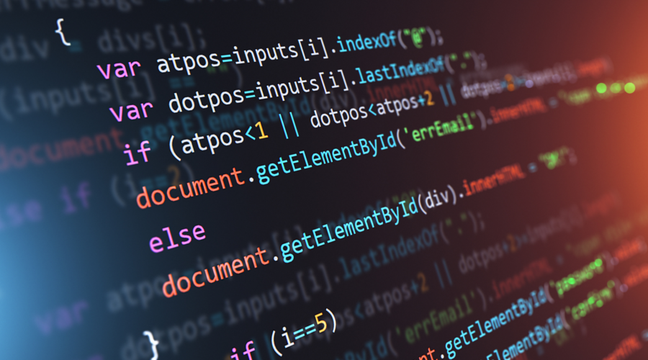
Programming Languages
Student:Rosca Dorin
Teacher:Crudu Corina

Slide 2
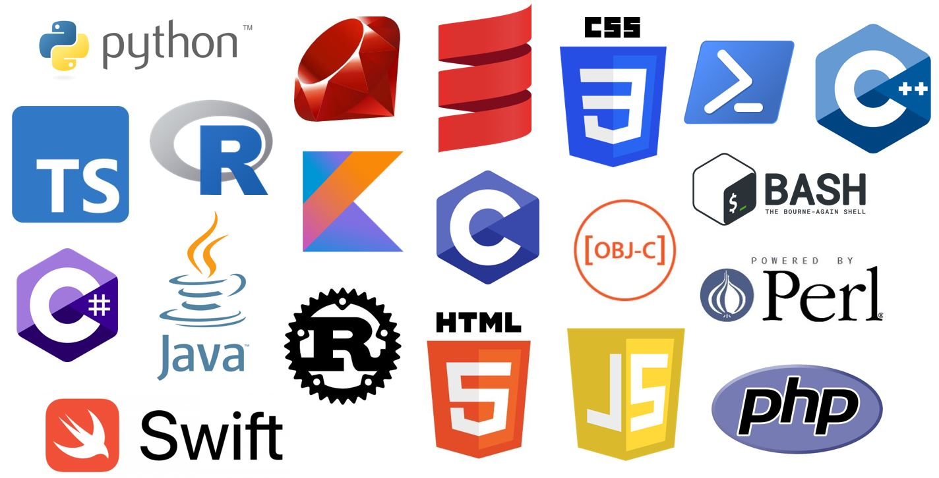
2
What are Programming Languages
Programming languages are a kind of computer language that are used in computer programming to implement algorithms.They consist of instruction for computers .By now ,there were created near 2000 programming languages. The description of them is usually split into the two components of syntax (form) and semantics (meaning), which are usually defined by a formal language.

Slide 3
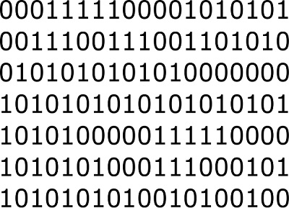
3
Since the early 1800s, programs have been used to direct the behavior of machines such as music boxes and playee pianos. The programs for these machines did not produce different behavior in response to different inputs or conditions.Programming languages started to develop in the middle of XIX century
History

Slide 4
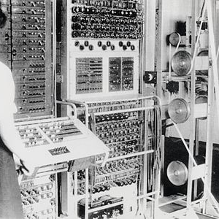
Also named first generation.
programs could be written in machine language, where the programmer writes each instruction in a numeric form the hardware can execute directly. For example, the instruction to add the value in two memory locations might consist of 3 numbers: an "opcode" that selects the "add" operation, and two memory locations.
First
Languages

Slide 5
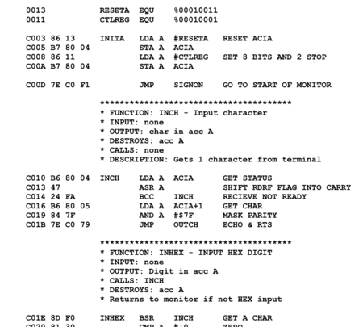
The next step was the development of the so-called second-generation programming languages or assembly languages, which were still closely tied to the instruction set architecture of the specific computer. These served to make the program much more human-readable
Second
Generations

Slide 6
High Level Programming languages
or third-generation programming languages , were written in the 1950s. In 1954, FORTRAN was invented . It was the first widely used high-level general purpose programming language to have a functional implementation, as opposed to just a design on paper. It is still a popular language for high-performance computing and is used for programs that benchmark and rank the world's fastest supercomputers

Slide 7
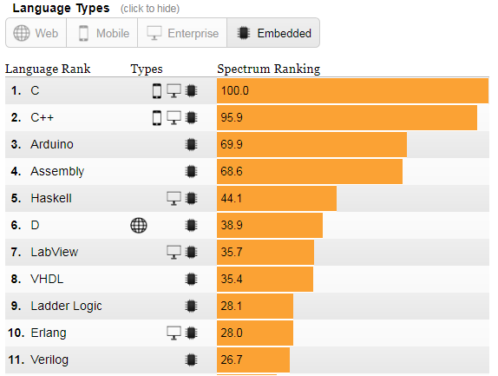
7
1960-1970
The increased use of high-level languages introduced a requirement for low-level programming languages or system programming languages. These languages, to varying degrees, provide facilities between assembly languages and high-level languages. They can be used to perform tasks that require direct access to hardware facilities but still provide higher-level control structures and error-checking.
In 1980-s was created C++

Slide 8
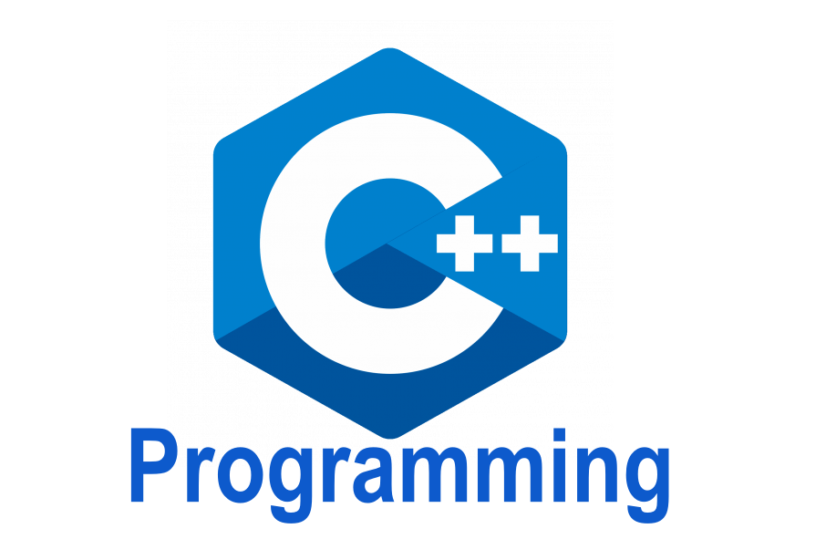
C++
was combined object-oriented and systems programming and became very fast the most used programming languageSafter ,the rapid growth of the Internet in the mid-1990s created opportunities for new languages.

Slide 9
In 90-s were created the most used programming languages Java and Pyton
Java is a statically typed and compiled language, and Python is a dynamically typed and interpreted language. This single difference makes Java faster at runtime and easier to debug, but Python is easier to use and easier to read.

